Slide 1
IDEALS MODEL OF PROBLEM SOLVING

Slide 2
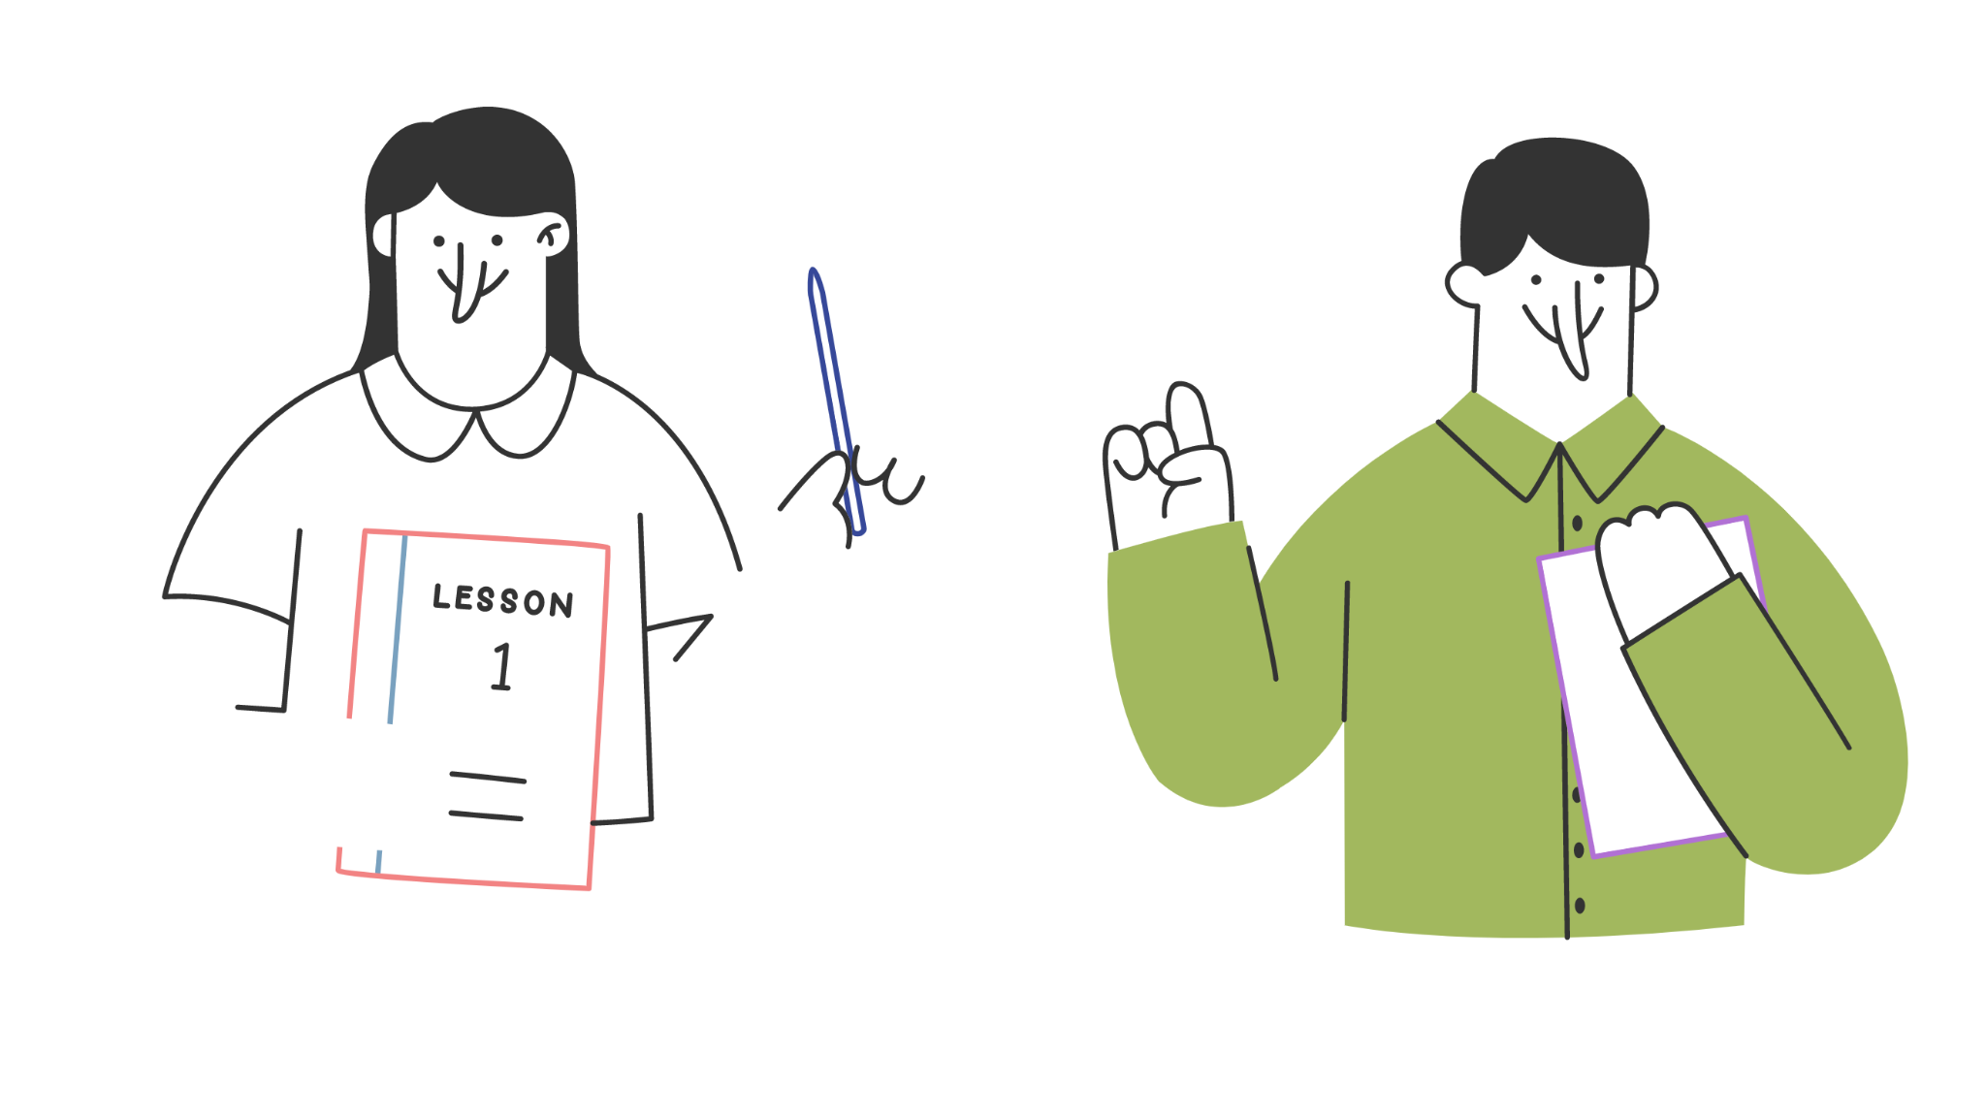





Team Members
HIMANSHI
(41221064)
SHREY THAKUR
(41221160)
SALONI
(41221143)
VIRAJ VERMA
(41221188)
SAPNA
(41221150)

Slide 3

IDEALS MODEL
OF PROBLEM SOLVING
SELF CORRECT
LIST
ANALYSE
ENUMERATE
DEFINE
IDENTIFY

Slide 4
IDEALS -Roadmap TO SOLVE PROBLEM
Recognizing the issue and understanding the problem
generating a list of reasons why the problem exists & better understanding of factors contributing to the problem
Brainstorming and considering all possible solutions relevant or irrelevant
IDENTIFY THE PROBLEM
ENUMERATE POTENTIAL CAUSES
LIST THE SOLUTIONS
1
3
5
2
4
6
DEFINE THE
PROBLEM
ANALYSE THE POTENTIAL CAUSES
SELF-CORRECT & EVALUATE THE SOLUTIONS
Clarifying-identifying the root cause and state the desired outcome
Implementing the chosen solution and monitoring progress with self-awareness, and a willingness to adapt and improve.
Analyze each cause by carefully observing, gathering data, and critical thinking skills.

Slide 5


1
IDENTIFYING THE PROBLEM
Ask yourself what it is that needs to be solved or accomplished?
Can it be fixed or improved?
Is it a real problem, or a symptom of a bigger problem?
PROBLEM : A group of students are struggling with their math homework
& assignments

Slide 6



2
DEFINING THE PROBLEM
finding the root cause of the problem?
How is it affecting?
What would you like to accomplish?
What is in the way?
DEFINING OUR PROBLEM : The students need to figure out why they are struggling with their math homework & assignments .
And to develop a plan to improve their understanding of the material.

Slide 7


3
ENUMERATE POTENTIAL CAUSES
Why the problem is occuring?
What are the possible causes ?
Where is problem?
Not understanding the subject
Not having enough practice problems
CAUSES :
Possible causes to figure out why they are struggling with their math homework & assignments can be:
Not being able to ask questions in class
not having enough time to complete the assignments.
Time management
Lack of resources for studying

Slide 8


4
ANALYSING THE POTENTIAL CAUSES
Finding out the major causes
Carefully observing
Gathering data
Critical thinking skills.
ANALYSIS OF PROBLEM :The students reviewed their homework assignments and class notes to analyse each of the causes and determine which factors are most likely to be contributing to their struggles.
Not having enough practice problems
Not being able to ask questions in class
Time management
Lack of
resources
for studying

Slide 9







LISTING THE SOLUTIONS
5
Brainstorming and considering all possible solutions
Making a list.
Drawing a mind-map.
Researching options online.
SOLUTIONS OF PROBLEM
Attending
tutoring
sessions for extra help
working through additional practice problems
Reviewing class notes and textbooks
managing time
more effectively
collaborating with peers to review material together

Slide 10





6
I
SELF-CORRECTING & EVALUATING THE SOLUTIONS
After weighing the pros and cons of each potential solution, choose the best strategy to execute & continuously evaluate your strategy
D
D
EVALUATION:
The students observed an improvement
They continued to monitor their progress and make adjustments
They also evaluated their study habits regularly to ensure they are effective & productive
E
A
L

Slide 11
Thankyou!

